Slide 1
Wireless Sensor Network Protocols
Nandini Mukherjee
Dept. of Computer Science and Engineering, Jadavpur University

Slide 2
Wireless Sensor Network Protocols
Objective: building longlived, massively-distributed, physically-coupled systems:
  The components are coordinating to minimize duty cycle and communication
    Adaptive MAC
    Adaptive Topology
    Routing
  In-network processing
    Data centric routing
    Programming models

Slide 3
Medium Access Control
We need to remember
  Transmissions are costly
  Receiving is about as expensive as transmitting
  Idling can be cheaper but is still expensive
MAC challenges
  Collision avoidance
  Latency
  Fairness
  Throughput
  Bandwidth utilization
  Energy efficiency
  Scalability in node density

Slide 4
Medium Access Control
Major sources of energy waste
  Collisions – wasted effort when two packets collide
  Overhearing – waste effort in receiving a packet destined for another node
  Idle listening – sitting idly and trying to receive when nobody is sending
    idle listening consumes 50–100% of the energy required for receiving
    In IEEE 802.11 ad hoc mode or in CDMA, nodes have to listen to the channel to receive possible traffic
  Control packet overhead - sending and receiving control packets consumes energy too.
  Protocol overhead

Slide 5
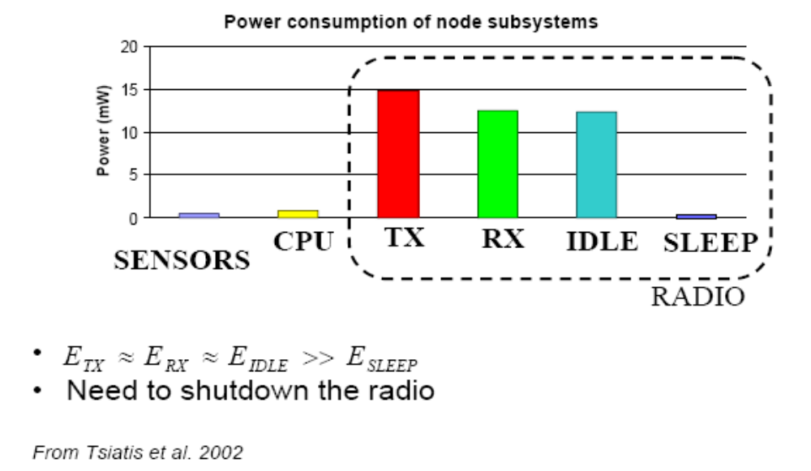
Energy Consumers

Slide 6
Sensor-MAC (S-MAC) Design
“An Energy-Efficient MAC Protocol for Wireless Sensor Networks” Wei Ye, John Heidemann and Deborah Estrin In Proceedings of the 21st International Annual Joint Conference of the IEEE Computer and Communications Societies (INFOCOM), Vol.3, pp. 1567-1576, New York, NY, USA, June, 2002.
Major components
  Periodic listen and sleep
  Collision avoidance
  Overhearing avoidance
  Message passing

Slide 7
Periodic Listen and Sleep
Problem: Idle listening consumes significant energy
Solution: Periodic listen and sleep
  Each node goes to sleep for some time, and then wakes up and listens to see if any other node wants to talk to it.
  Turns off radio when sleeping, sets a timer to awake itself later
  The duration of time for sleeping can be selected (depends on the application, for simplicity it is same for each node)
    a complete cycle of listen and sleep is called a frame
    The duration of listen is normally fixed according to physical-layer and MAC-layer parameters, e.g., the radio bandwidth and the contention window size
  Reduce duty cycle to ~10% (200 ms on/2s off)
  Increased latency for reduced energy
    since a sender must wait for the receiver to wake up before it can send out data.

Slide 8
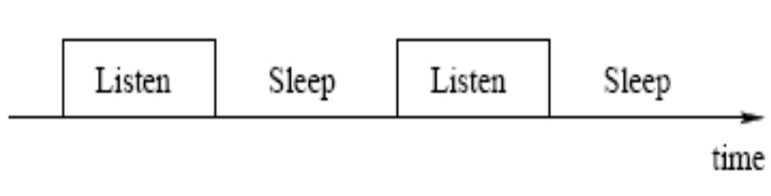
Periodic Listen and Sleep
All nodes are free to choose their own listen/sleep schedules
Sleep / Listen schedules among the nodes can differ
It is preferable that the neighboring nodes synchronize together
  Nodes exchange their schedules by broadcasting them to all the immediate neighbors
  easy broadcast & low control overhead
Two neighboring nodes A and B may have different schedules if they each in turn must synchronize with different nodes

Slide 9
Schedule Maintenance
A node choose a schedule and exchange it with its neighbors
  The node first listens for a certain amount of time
  If it does not hear a schedule from another node, it randomly chooses a time to go to sleep and immediately broadcasts its schedule in a SYNC message, indicating that it will go to sleep after t seconds.
  The node becomes a synchronizer node. Other nodes synchronise with it
If the node first receives a schedule from a neighbour
  It sets its own schedule with that time
  Becomes a follower node
  The node waits for a random delay t_{d} and rebroadcasts this schedule indicating that it will sleep in t-t_{d} seconds
  Random delay is for collision avoidance among multiple followers
If a node receives a different schedule after it broadcasts its own schedule, two cases may occur:
  If the node has no other neighbors, it will discard its current schedule and follow the new one
  If the node has one or more neighbors, it adopts both schedules by waking up at the listen intervals of two different schedules
  Broadcasts its own schedule before going to sleep

Slide 10
1)
Node 'A' Listens
CS
ASYNC
3)
x
t
SYNC period
N_{A}
ASYNC
ASYNC
Boot up
SYNC period >= x
BSYNC
A
B
BSYNC
CS
ASYNC
N_{A}
ASYNC
ASYNC
t
SYNC period
2)
Node 'A' Listens
CS
A
SYNC
B
SYNC
t
Receives no SYNC from another node so chooses and follows own schedule
But then receives SYNC from another node B.

Slide 11
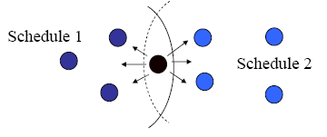
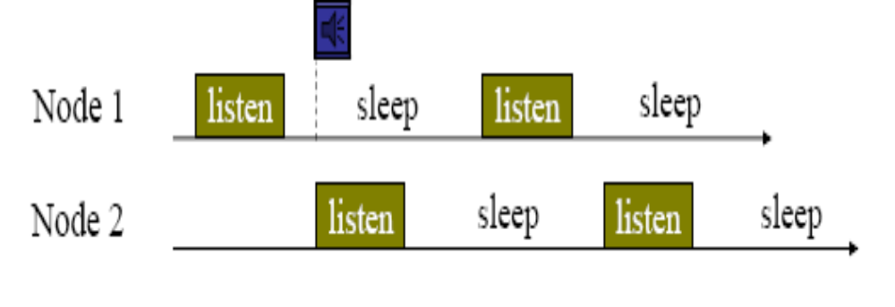
Periodic Listen and Sleep

Slide 12
Maintaining Synchronization
Each node maintains a schedule table that stores the schedules of all its known neighbors
Maintaining Synchronization
  Nodes exchange their schedules by periodically broadcasting a SYNC packet to their immediate neighbors
  The period for each node to send a SYNC packet is called the synchronization period.
  Neighboring nodes need to periodically inform each other their schedules to prevent long-time clock drift
  Updating schedules is also done by sending a SYNC packet
  SYNC is a very short message and includes the address of the sender and the time of its next sleep

Slide 13
Maintaining Synchronization
Listen interval is divided into two parts
The first part is for receiving SYNC packets, and the second one is for receiving RTS packets
Each part is further divided into many time slots for senders to perform carrier sense
For example, if a sender wants to send a SYNC packet, it starts carrier sense when the receiver begins listening. It randomly selects a time slot to finish its carrier sense. If it has not detected any transmission by the end of the time slot, it wins the medium and starts sending its SYNC packet at that time.
The same procedure is followed when sending data packets.

Slide 14
Listen period
CTS
ACK
Node A
t
Transmit data if no current transmission
CS
RTS
DATA
Node B
t
CS = Carrier Sense RTS = Request to send CTS= Clear to send

Slide 15
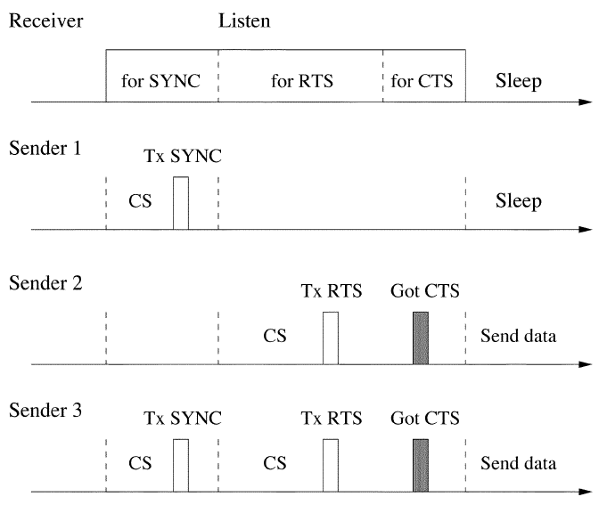
Receive Data

Slide 16
Collision Avoidance
Problem: Multiple senders want to talk
Solution: Similar to IEEE 802.11 ad hoc mode (DCF)
  Contention-based scheme
Physical and virtual carrier sense
  For physical carrier sense randomized CS times are selected
  For virtual carrier sense
    A duration field in each transmitted packet indicates how long the remaining transmission will be
    When a node receives a packet (destined to another node), the node records this value in NAV variable (network allocation vector) and sets a timer
    When the NAV timer fires, the node decrements the NAV value
    When a node has data to send, it first looks at the NAV. If its value is not zero, the node determines that the medium is busy
The medium is determined as free if both virtual and physical carrier sense indicate that it is free.
If a node fails to get the medium, it goes to sleep and wakes up when the receiver is free and listening again

Slide 17
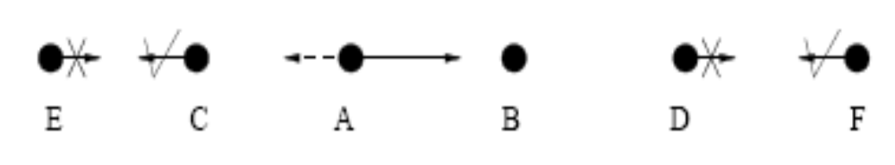
Overhearing Avoidance
Problem: Receive packets destined to others
Solution: Sleep when neighbours talk
  Interfering nodes go to sleep after they hear an RTS or CTS packet.
  Basic idea from PAMAS (Singh 1998)
  Who should sleep?
    All immediate neighbours of sender and receiver
  How long to sleep?
    The duration field in each packet informs other nodes the sleep interval (NAV)
D should go to sleep since its transmission interferes with B’s reception. E and F do not need to go to sleep. C’s transmission does not interfere with B’s reception, so C is free to transmit to neighbors like E. However, C is unable to get any reply from E, e.g., CTS or data, because E’s transmission collides with A’s transmission at node C.

Slide 18
Message Passing
A message is a collection of meaningful, interrelated units of data.
Problem: In-network processing requires entire message
  transmitting a long message as a single packet implies high cost of re-transmitting it in case of any transmission error
  fragmenting the long message into many independent small packets means paying the penalty of large control overhead and longer delay
Solution: No interleaving of different messages
  Long message is fragmented & sent in burst
  RTS/CTS reserve medium for the entire message
  Every time a data fragment is transmitted, the sender waits for an ACK from the receiver. If it fails to receive the ACK, it will extend the reserved transmission time for one more fragment, and re-transmit the current fragment immediately.
  Fragment-level error recovery when no ACK received for a fragment
  Other nodes sleep for the entire message time

Slide 19
Energy Savings vs. Increased Latency
For a packet moving through a multi-hop network, the following delays are experienced at each hop:
  Carrier sense delay is introduced when the sender performs carrier sense.
  Backoff delay happens when carrier sense fails, either because the node detects another transmission or because collision occurs
  Transmission delay is determined by channel bandwidth, packet length and the coding scheme adopted
  Propagation delay is determined by the distance between the sending and receiving nodes (can be ignored in case of WSN)
  Processing delay occurs because the receiver needs to process the packet before forwarding it to the next hop
  Queuing delay depends on the traffic load
An extra delay in S-MAC is caused by periodic sleeping of nodes (a sender must wait until the receiver wakes) – called sleep delay

Slide 20
Adaptive Listening
A node, if it overhears its neighbor’s transmissions (RTS or CTS) wakes up for a short period of time at the end of the transmission
  duration field is observed from the RTS and CTS packets
Thus, if the node is the next-hop node, its neighbor is able to immediately pass the data to it instead of waiting for its scheduled listen time
If a node does not receive anything during the adaptive listening, it will go back to sleep until its next scheduled listen time.
SYNC packets are not sent during adaptive listening

Slide 21
B waiting for C to wake up...
Event
Sensed
C wakes up...
A
B
C
Adaptive Listening
C now knows from duration field when the transmission will end
Event
Sensed
A
CTS
B
CTS
C
C wakes up at end of transmission

Slide 22
Timeout-MAC (T-MAC)
In S-MAC, active period is of constant length
  fixed duty cycle and not optimal
Problem: What if no traffic actually happens?
  Nodes stay awake needlessly long
Solution: Prematurely go back to sleep mode when no traffic has happened for a certain time (=timeout)
  Adaptive duty cycle
  One ensuing problem: Early sleeping
    C wants to send to D, but is hindered by transmission from A to B and D goes to sleep

Slide 23
  Reduce idle listening by transmitting data in bursts
  Sleep in between bursts to save power
  End the active time in an intuitive way
  Timeout on hearing nothing
Every node periodically wakes up and communicates with its neighbors
A node will keep listening and potentially transmitting, as long as it is in active period
An active period ends when no activation event has occurred for time TA

Slide 24
T-MAC : Activation event
The firing of periodic timer
The reception of any data on radio
The sensing of communication on the radio
The end of transmission of a node’s own data packet
The knowledge through prior RTS and CTS packets

Slide 25
T-MAC
A node will sleep if it is not in an active period
TA determines the minimum amount of idle listening per frame
All communication occurs as a burst in the beginning of the frame
Buffer capacity determines the upper bound on the maximum frame time

Slide 26
Timeout-MAC (T-MAC)
Adaptive duty cycle:
A node is in active mode until no activation event occurs for time TA
  Periodic frame timer event, receive, carrier sense, send-done, knowledge of other transmissions being ended
Communication ~= S-MAC
Frame schedule maintenance ~= S-MAC
Active
Active
Active
Sleep
Sleep
TA
TA
TA

Slide 27
T-MAC: RTS Operation
Contention Interval
waiting/listening for a random time within a fixed contention interval (unlike exponential back-off in 802.11)
  Tuned for max. load

Slide 28
T-MAC: Early-Sleeping Problem
C may lose medium to B (RTS) or A (B’s CTS)
C loses to B; D will hear CTS from C;
C loses to A; D will hear nothing, since C is silent;
contend
RTS
CTS
DATA
ACK
A
B
contend
C
active
sleep
D
RTS?
TA

Slide 29
In order to communicate with D node C has to contend for the transmission channel. Node C may lose the contention of the transmission channel to node A or node B. If node C loses the contention due to a RTS packet from node B, node C shall send a CTS reply to B, which will be overheard by node D. Accordingly node D can anticipate itself as the subsequent receiver and wake up when the communication between C and B is over. However, C must remain silent if node C loses the contention due to overhearing the CTS packet from B to A. In this case node D, who is totally blind to the communication between A and B, will go to sleep after the expiration of the TA timer. Hence, even in next contention round, node C wins the contention, node C cannot talk with node D who is in sleep state. This observed behavior is called early sleeping problem since a node moves to sleep state even though a neighbor intends to communicate with it.

Slide 30
Preamble Sampling
In S-MAC periodic sleeping is supported by synchronizing wake up of nodes to ensure communication between sender and receiver
Alternative Solution:
  Have receiver sleep and only periodically sample the channel
Use long preambles to ensure that receiver stays awake to catch actual packet
  Example: WiseMAC
Start transmission:
Long preamble
Actual packet
Check
channel
Check
channel
Check
channel
Check
channel
Stay awake!

Slide 31
B-MAC
A CSMA-CA scheme
Primarily focus on Backoff and Clear Channel Assessment
Backoff
  Instead of embedded into the MAC layer, a policy manager or application control of the initial backoff is advocated before submitting a packet for transmission
  This help to achieve highest channel utilization and allows the application to control the backoff for each packet
  Examples:
    Bulk data transfers may not want any initial backoff
    Responses to broadcast messages requires a random backoff
    The backoff after sending a multihop message should be two packet times such that it does not interfere with its parent’s retransmission.
  For congestion backoff, the application is signaled for a backoff value
  If the application chooses not to handle this event, a default handler chooses a random backoff between 0 and 6 ms uniformly.

Slide 32
B-MAC
Clear Channel Assessment
  Usual algorithm
    A node wakes up, runs the CCA algorithm, and receives data from the channel if it is busy
    If the channel is clear, the node returns to sleep
    May run at a 1% duty cycle in WSN applications
  Clear Channel Assessment in B-MAC
    Based on continuous noise floor estimation
    Consists of an algorithm for estimation of the noise floor and a CCA function that is called when the status of the channel is requested

Slide 33
B-MAC
Clear Channel Assessment in B-MAC
  Noise Floor Estimation
    When it appears that the channel is clear, the signal strength is sampled and added to a FIFO queue
    The median sample is taken from the queue and the noise floor estimation is updated using an exponentially weighted moving average with coefficient α
  When a packet arrives and the signal strength increases
  For actual assessment when sending a packet, look at s (say five) channel samples – channel is free if even a single one of them is significantly below noise
“Sensor Network Media Access Design” by Joseph Polastre of University of California, Berkeley
Optional: random backoff if channel is found busy
Optional: Immediate link layer acknowledgements for received packets

Slide 34
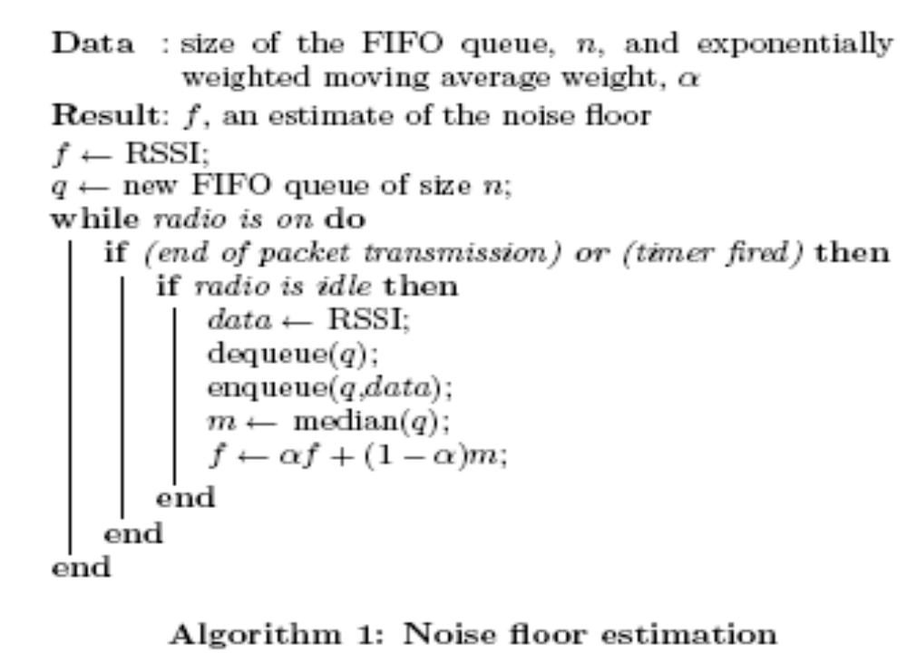

Slide 35
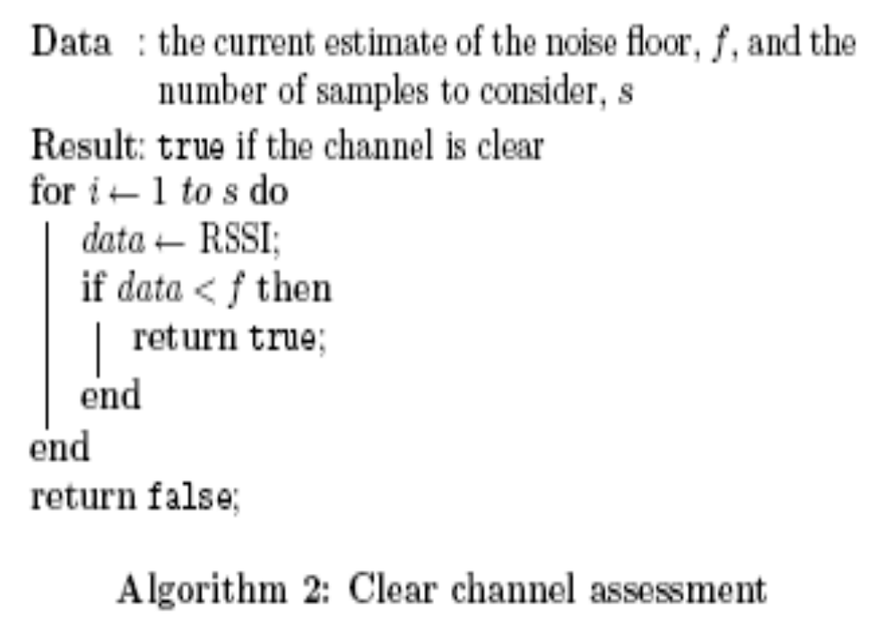

Slide 36
B-MAC: Low Power Listening
Goal: minimize listen cost
Sleep/Wake scheduling using Low Power Listening (LPL)
    Wake up every Check-Interval
    Sample Channel using CCA
    If no activity, go back to sleep for Check-Interval
    Else start receiving packet
  Advantage of this technique is that it works in a completely unsynchronized environment

Slide 37
Rx
Check interval
Receive data
Carrier sense
Tx
Long preamble
Data transmission

Slide 38
B-MAC
B-MAC does not have
  Synchronization
  RTS/CTS
Results in simpler, leaner implementation
Clean and simple interface

Slide 39
Schedule-based protocols
SMACS
  A distributed infrastructure-building protocol that forms a flat topology and enables nodes to discover their neighbors
  The neighbor discovery and channel assignment phases are combined in SMACS, so after a node hears from all neighbors, they can form a connected network
  Channels or links are defined as pairs of time intervals, similar to slots in a TDMA schedule
  A collection of nodes start discovering their neighbors and establish transmission/reception schedules for communicating with them
  To reduce the likelihood of collisions, we require each link operates on a different frequency
  Thus, Link is frequency band + time slot at both sender and receiver
  Frequency band is picked up randomly, slot is searched greedily until a collision-free slot is found
  A superframe of fixed length is defined
  As new neighbors are found and new links formed, the superframe of each node will start to be filled
  Receivers sleep and only wake up in their assigned time slots, once per superframe
  In effect: a local construction of a schedule

Slide 40
Schedule-based protocols
SMACS link setup
  Case 1: Node X, Y both so far unconnected
    Node X sends invitation message
    Node Y answers, telling X that is unconnected to any other node
    Node X tells Y to pick slot/frequency for the link
    Node Y sends back the link specification
  Case 2: X has some neighbors, Y does not
    Node X will construct link specification and instruct Y to use it (since Y is unattached)
  Case 3: X has no neighbors, Y has some
    Y picks link specification
  Case 4: both nodes already have links
    Nodes exchange their schedules and pick free slots/frequencies in mutual agreement

Slide 41
Schedule-based protocols
The following messages are exchanged between nodes when they are searching for new neighbors:
  TYPE1: a short invitation containing a node’s id and number of attached neighbors. The node which sends it is the inviter during the search transaction.
  TYPE2: a response to TYPE1. The node that sends it will be an invitee. There may be more than one invitee for each inviter. This message gives the inviter and invitee's addresses, and invitee's attached state.
  TYPE3: response to TYPE2. It indicates which invitee was chosen. It contains the following additional information depending on the node's attached state:
    Inviter not attached: none
    Invitee, inviter attached: inviter's schedule and frame epoch
    Invitee not attached, inviter attached: proposed channel for the link, calculated by inviter
  TYPE4: response to TYPE3. Message contents are as follows:
    Invitee not attached, inviter not attached: channel determined by the invitee
    Invitee not attached, inviter attached: none
    Invitee attached, inviter not attached: channel determined by the invitee
    Invitee attached, inviter attached: channel determined from own and inviter's schedule information

Slide 42
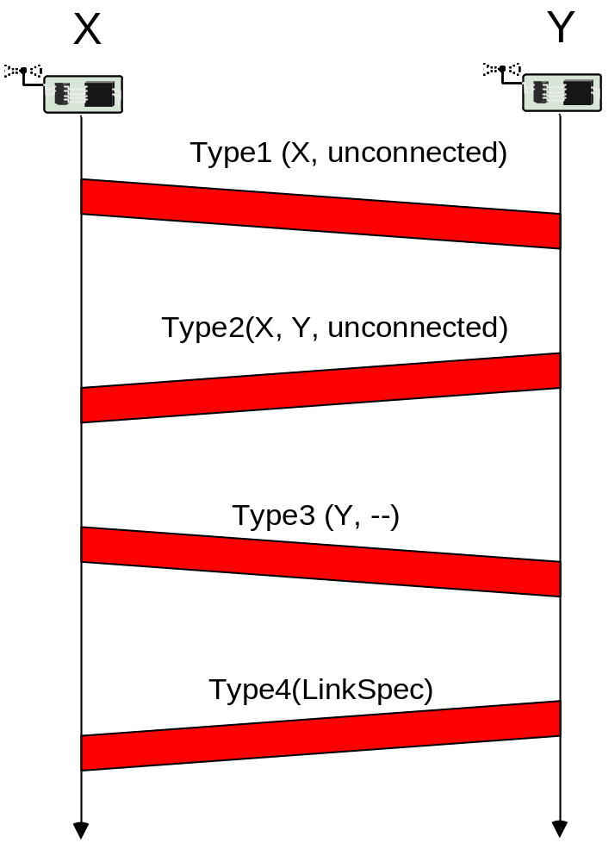

Slide 43
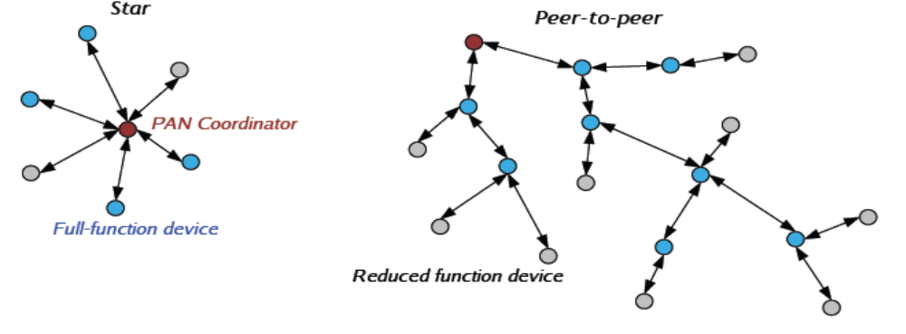
IEEE 802.15.4
Network Topologies
  Every network has a unique Personal Area Network Coordinator
  Coordinator is responsible for network management tasks, e.g., associating new nodes, transmitting beacons, etc.
    Star network: All nodes must talk to PAN (like 802.11)
    Peer-to-peer network: Individual nodes can talk to each other
      can be ad hoc, self-organizing and self-healing
  Only Full Function Devices can actually route messages

Slide 44
IEEE 802.15.4
Node functionality
  PAN coordinator
    Initiates the network and the primary controller of the network
    May transmit beacons and can communicate directly with any device in the range
  Coordinator
    May transmit beacons and can communicate directly with any device in the range
    Can be a PAN coordinator if it starts a new network
  Device
    Does not beacon and can directly communicate only with a coordinator
Full Function Device (FFD) – can operate at any of the three roles. Must have sufficient memory to store routing information
Reduced Function Device (RFD) – a low cost device with minimal memory requirement. Can only function as a network device

Slide 45
IEEE 802.15.4 - Physical
802.15.4 defines several frequency ranges:
  Upper band:
    16 channels in the 2.4 GHz band (5 MHz per channel)
  Lower band:
    10 channels in the 915 MHz band (2 MHz per channel)
    1 channel in the 868 MHz band
BPSK for lower band
Direct Sequence spreading used for 2.4 GHz band
  Each 4-bit nibble mapped onto 32-bit chipping code
  Modulated using offset-QPSK
Data transmitted at a rate of 2 million chips/sec
  32-bit chip maps onto 4-bit raw data symbol
  So, effective data rate is ( (2,000,000) / (32) ) * 4 = 250,000 bits/sec
Note that this is only 244 Kbps if 1 Kbit = 1024 bits.

Slide 46
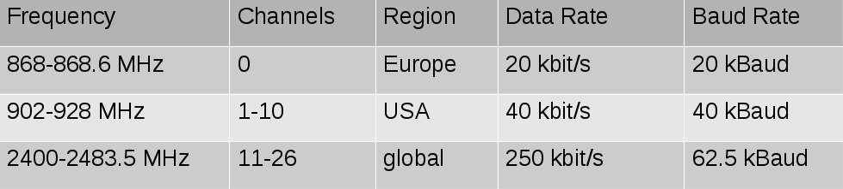

Slide 47
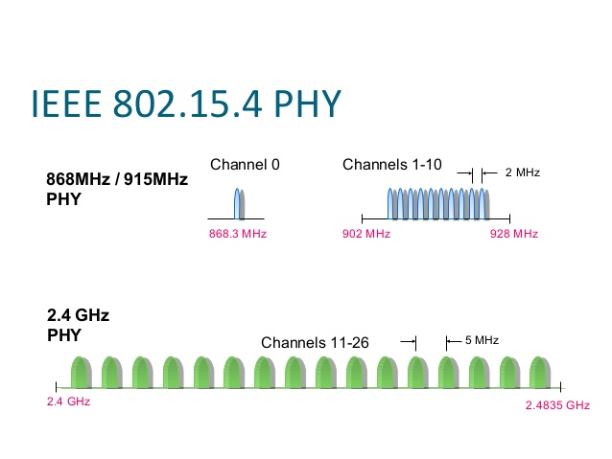

Slide 48
IEEE 802.15.4
General Features
  Star or peer-to-peer operation
  Allocation of guaranteed time slots (GTSs)
  Carrier Sense Multiple Access with Collision Avoidance (CSMA-CA) channel access
  Low power consumption
  Energy detection (ED)
    When interference from other services appear on a channel, the coordinator scans each alternative channel and obtains a measure of the peak energy in these channel to select a more suitable channel
    Clear channel assessments are performed as part of CSMA-CA mechanism to ensure the channel is unoccupied prior to transmission
  Link quality indication (LQI)
    An LQI byte is attached to each received frame by the physical layer

Slide 49
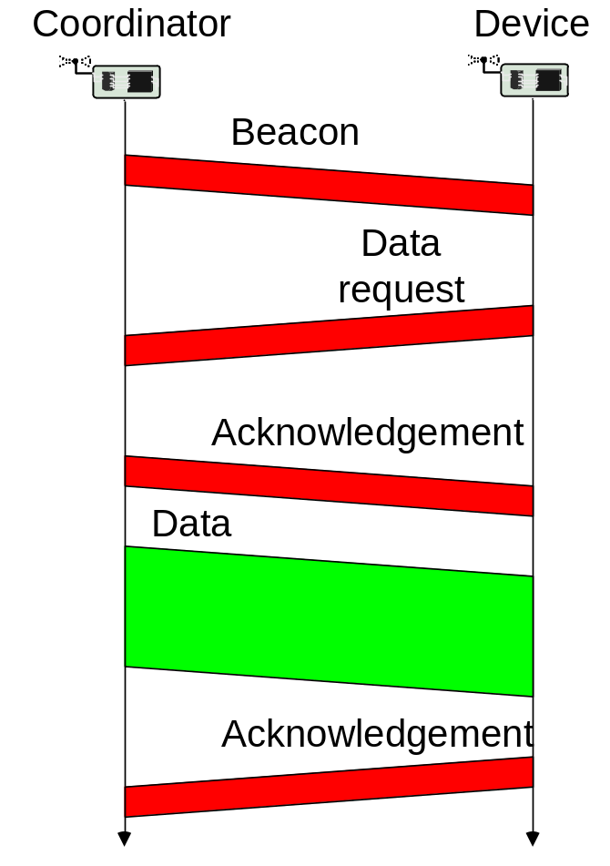
IEEE 802.15.4 - MAC
Star networks: devices are associated with coordinators forming a PAN
  identified by a PAN identifier
Coordinator
  does the bookkeeping of devices, address assignment, generate beacons
  talks to devices and peer coordinators
All the nodes attached to the coordinator are synchronized by the beacon frames periodically broadcast by the coordinator

Slide 50
IEEE 802.15.4 - MAC
Beacon-mode superframe structure
  Between two consecutive beacon frames, the time is equally divided into 16 slots, each equals to the beacon frame duration
  The beacon frame is sent in the first slot of each superframe
  If a coordinator does not want to use the superframe structure, it may turn off the beacon transmissions
  The beacons are used to synchronize the attached devices, to identify the PAN and to describe the structure of superframes.
The superframe can have an active and an inactive portion
During the inactive portion, the coordinator shall not interact with its PAN and may enter a low-power mode.

Slide 51
IEEE 802.15.4 - MAC
The active portion consists of contention access period (CAP) and contention free period (CFP)
Any device wishing to communicate during the CAP shall compete with other devices using a slotted CSMA-CA Mechanism
The CFP contains guaranteed time slots (GTSs)
The PAN coordinator may allocate up to seven of these GTSs and a GTS can occupy more than one slot period.
  Contention Free Period <= 7slots
GTS (Guaranteed Time Slots) to various nodes are assigned to devices upon request
  as in TDMA
  assignment is performed by PAN Coordinator
Information about GTS for various nodes is mentioned in the beacon

Slide 52
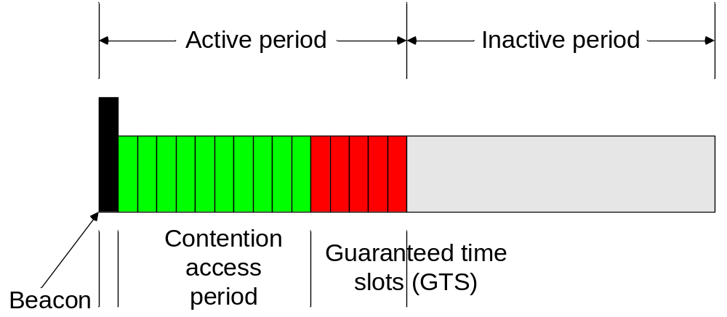
A coordinator can put the nodes attached to it into power saving mode by increasing the interval period of beacon frames
  the beacon interval is a multiple of one base Superframe Duration

Slide 53
Basic MAC Scheme
Beacon messages are not subject to CSMA
  Used to coordinate network and are not expected to suffer collisions
CSMA/CA scheme
  Nodes listen before transmitting
  Random backoff between 0 – N time slots
  Double N each time a collision occurs
Transmitter can request ACK for each message
  Bit set in header to tell receiver an ACK is needed
  ACK will be transmitted shortly after reception (without CSMA)
  Unacknowledged messages will be retransmitted up to some fixed number of times

Slide 54
Power Saving Features
To save power, a node's radio may be put to power down
Coordinator can define idle period within the superframe
  all nodes can sleep during that time (even the coordinator)
However, individual nodes can enter a low-power state any time
  The receiver won't hear any incoming transmissions ....

Slide 55
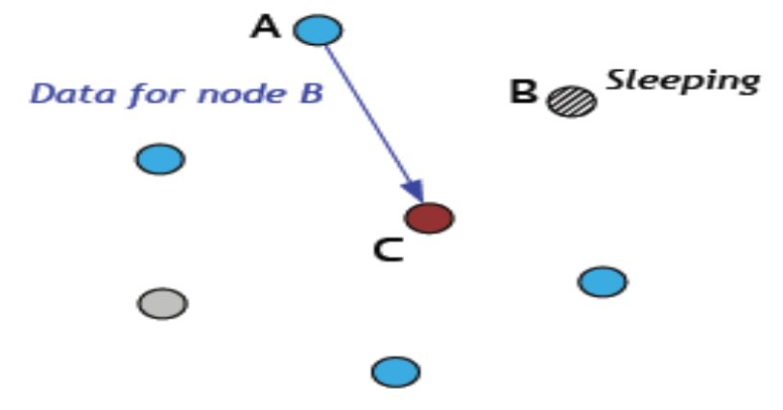
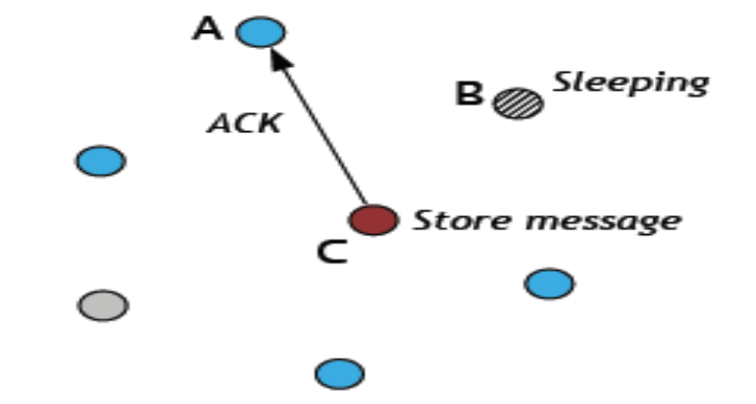
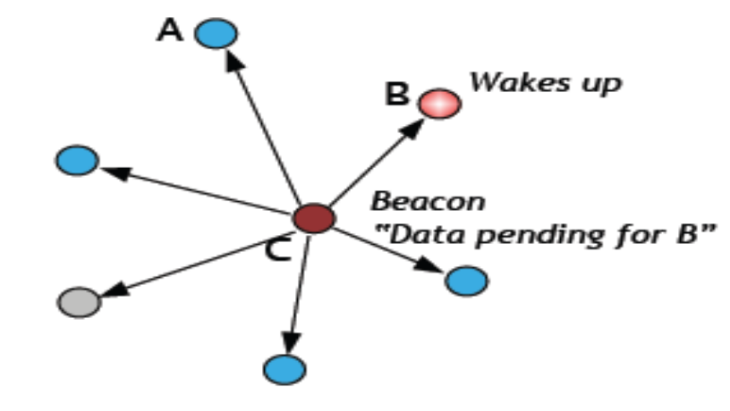
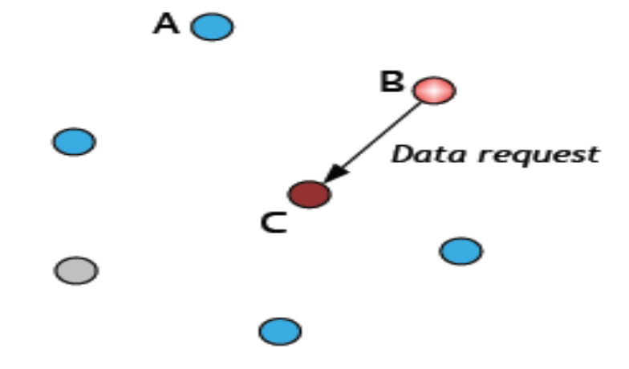
Power Saving Features
A solution: Poll-based transfer

Slide 56
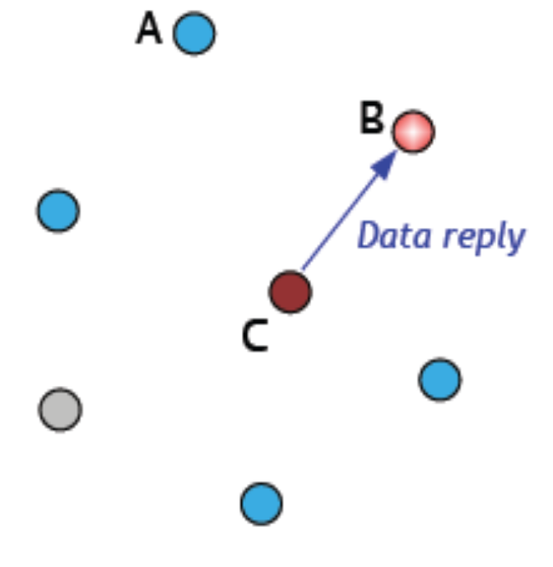
Poll-based transfer
Allows nodes to sleep when not requiring use of the radio
Increases latency for communications
Requires coordinator to buffer messages for individual nodes.

Slide 57
Backoff
Of primary concern in achieving high channel utilization in CSMA schemes is the initial and congestion backoff algorithm.
The initial backoff is the time a transmitter delays from the point that a packet is submitted for transmission to the first time the status of channel is evaluated.
The congestion backoff is the time a transmitter delays after checking the status of a channel and determining that the channel is busy.

